Slide 1
Just apply – Intelligent Job Recommendation System
Daniel Aigbe – B00150058
Supervisor: Luke Raeside
School of Computing — Technological University Dublin
A cloud-based platform that uses NLP and analytics to match CVs to relevant job opportunities.
Notes:
1

Slide 2
Introduction
Problem & Motivation
System Architecture
Current Progress
Future Development Roadmap
Technologies & Justification
End.
2
Notes:
2

Slide 3
Problem & Motivation
The Problem
Traditional job platforms rely on keyword matching, leading to poor recommendation accuracy.
Manual CV screening is slow, biased, and inconsistent.
Job seekers struggle to identify missing skills and suitable career paths.
Motivation (Backed by Research)
NLP enables extraction of skills, qualifications, and experience from unstructured CVs.
Cloud computing ensures scalability, secure storage, and global accessibility.
Data analytics supports labour-market insights and personalised recommendations.
Notes:
3

Slide 4
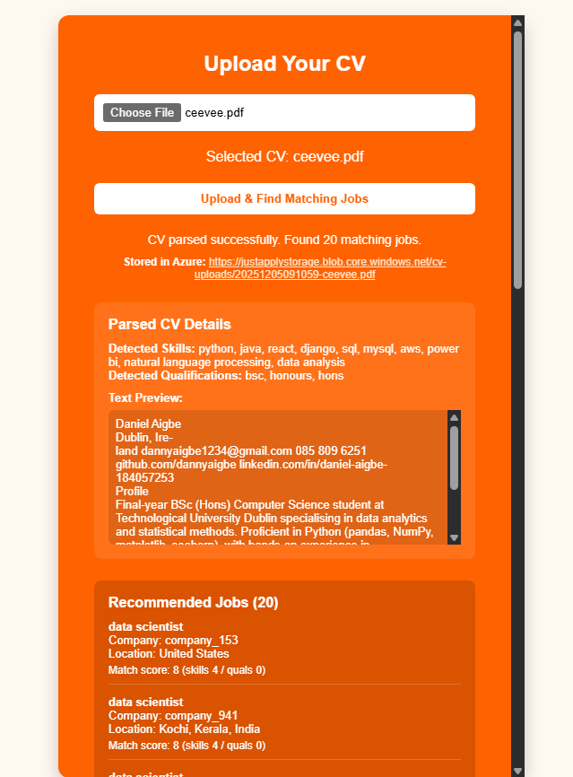
System Architecture
How the System Works
User > Next.js Frontend > Flask API > NLP Processing > Azure Blob Storage > Azure SQL (planned) > Job Matching > Results UI
Core Components
Next.js Frontend – CV upload + job results UI
Flask Backend – API endpoints + NLP processing
NLP Pipeline (NLTK, Punkt) – skill + qualification extraction
PDF/DOCX Parsing – PyPDF2 & python-docx
Azure Storage – secure CV storage
Recommendation Engine – keyword similarity, match scoring
Notes:
4

Slide 5
Current Progress (Implementation)
Completed
CV Upload fully functional
Parsing text from PDF/DOCX
NLP skill extraction (keyword + tokenization)
Qualification detection (degree, certifications)
End-to-end integration: Next.js > Flask > Azure Blob Storage
Text preview of parsed CV content
Working API for returning skills + qualifications
Demonstrates
Full prototype pipeline in place
Core NLP + cloud components already implemented
Notes:
5

Slide 6
Future Development Roadmap
Planned Features
Full job matching engine (TF-IDF / cosine similarity etc not entirely sure though)
Azure SQL integration for storing job listings & extracted CV data
User accounts + saved jobs
Missing skill analysis with upskilling suggestions
Admin dashboard for job + user management
Analytics dashboard (labour-market insights)
Deployment to Azure/Vercel
Goal
A fully cloud-hosted, intelligent recruitment platform.
6
Notes:
6

Slide 7
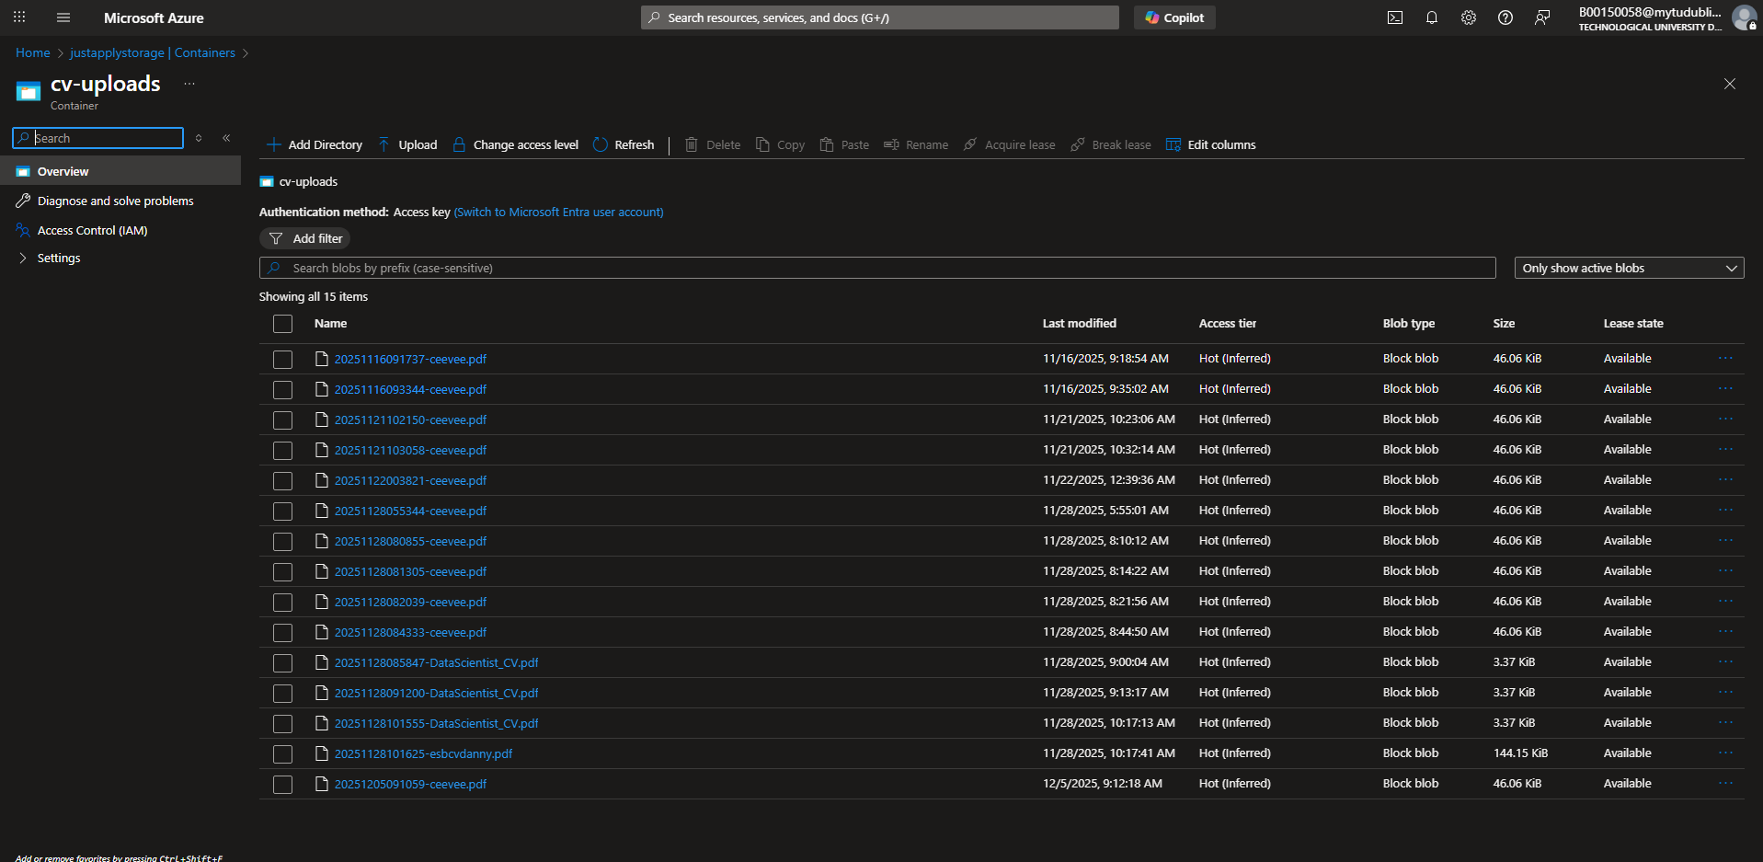
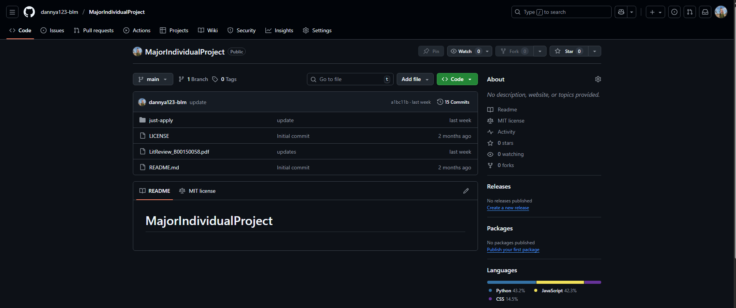
Technologies
Technologies Used
Frontend: Next.js (React framework)
Backend: Flask (lightweight API for NLP)
Languages: Python, JavaScript
NLP: NLTK, Punkt tokenization
File Parsing: PyPDF2, python-docx
Cloud: Azure Blob Storage, Azure SQL (planned)
Deployment: Vercel / Azure App Service (planned)
Why These Choices?
Lightweight NLP > fast + efficient for student project constraints
Flask > simple microservice architecture
Azure > secure, scalable CV storage
Next.js > modern, responsive UI for job results
7
Notes:
7

Slide 8

Thank you
Notes:
8

